Slide 1
Hackathon Sponsorship
Bringing Your Budget to the Next Level
Irfaan Khalid, VandyHacks
HackCon V | August 5, 2017 | East Stroudsburg, PA
Notes:
0:30 | 0:30

Slide 2

Hi!
My name is Irfaan Khalid.
(Pronouns: He, Him, His)
I love hackathon organizing and hackathon sponsorship.
Notes:
0:15 | 0:45

Slide 3
Facts About Me
I’m an organizer for VandyHacks at Vanderbilt University.
I’m a public speaker, photographer, sneakerhead, and occasional rapper.
I dressed up as a squirrel at VandyHacks III last fall.
Notes:
0:45 | 1:30

Slide 4
$63,800
11
441
Total budget
Sponsors
Hackers
Notes:
0:15 | 1:45

Slide 5
Notes:
0.25 minutes | 2.00 minutes

Slide 6
Hackathon Sponsorship
is all about finding great companies to support and participate in your event.
Notes:
0:15 | 2:15

Slide 7
BUDGET
BRAINSTORM COMPANIES
NETWORK
HOST A
GREAT EVENT!
SEAL
THE
DEAL
REACH
OUT
Notes:
1:15 | 3:30

Slide 8
Workshop Goals
Notes:
0:15 | 3:45

Slide 9
Let’s focus.
Reinforcing Your Hackathon’s Foundation
Take advantage of your resources and maximize your budget.
Hackathon 2.0
Use your maximized budget to host truly a truly premiere event!
Remember: This is NOT Sponsorship 101!
Notes:
0:45 | 4:30

Slide 10
Let’s get down to business.
Split up into groups of 4
Be ready to participate in group discussions
Feel free to ask questions!
We’ll also have an open Q&A at the end
Notes:
1:30 | 6:00

Slide 11
Bringing Your Budget
to the Next Level
Ten tips and tricks to optimize your sponsorship process
Notes:
0:15 | 6:15
Encourage questions, and note that we’ll have a Q&A with our remaining time.

Slide 12
Stay organized,
stay consistent.
Notes:
0:15 | 6:30

Slide 13
Stay organized, stay consistent.
Have a master spreadsheet
Companies and contacts
Contact ledger
Financial ledger
Establish a workflow
Emails on Tuesdays and Thursdays
It’s a team effort!
Notes:
1:30 | 8:00
NOTE
Mention how to organize this well to pass it onto the next organizing team(s)
Discussion about how to formulate an ideal budget?
Example emails - good email vs bad email

Slide 14
Remember: It’s a team effort!
Notes:
0:15 | 6:30

Slide 15
Remember: It’s a team effort!
Inside of your organization...
Send emails together!
Work together to find contacts
Seek out each other’s feedback
… and out!
Network with other organizers
Swap contacts
Share strategies

Slide 16
Network, network,
network!
Notes:
0:15 | 10:15

Slide 17
Network, network, network!
Career fairs and recruiting events
Talk to other organizers
Only talk to their sponsors on-site with permission
School faculty
Notes:
1:15 | 11:30

Slide 18
Be smart with your budget.
Notes:
0:15 | 11:45

Slide 19
Be smart with your budget.
Budget before you start reaching out
Set reasonable tiers
Have a 10-15% emergency fund
Keep in mind all costs you could have
Including HackCon expenses ;)
Notes:
1:15 | 13:00

Slide 20
Sample Budget
$20000 - Food
$20000 - Travel
$20000 - Hacker Experience
$ 8000 - Emergency Fund
$ 5000 - HackCon
$ 4000 - Venue + Housekeeping
$ 2500 - Hack Nights
$ 500 - Marketing
$80000 - Total
Notes:
0:30 | 13:30
NOTE
Research budgets vs event size, show graphs

Slide 21
GROUP DISCUSSION
What are some budgeting mistakes you’ve made or seen other organizers make, and how could they have been prevented?
Notes:
2:00 | 15:30
Talk amongst your groups, and we’ll reconvene in a minute to share some of our thoughts.

Slide 22
Let your prospectus do the talking.
Notes:
0:15 | | 15:45

Slide 23
Let your prospectus do the talking.
Find a great graphic designer
Include info and stats about past events
Keep it:
Easy-to-read
Clean and simple
Concise
Notes:
1:15 | 17:00

Slide 24


Notes:
0:30 | 17:30
Highlight the following: Attractive cover page, easy to read, not too long, colors pop, stats are bolded, data is clear
NOTES
Other stats sponsors would like/what else sponsors would wanna see?

Slide 25
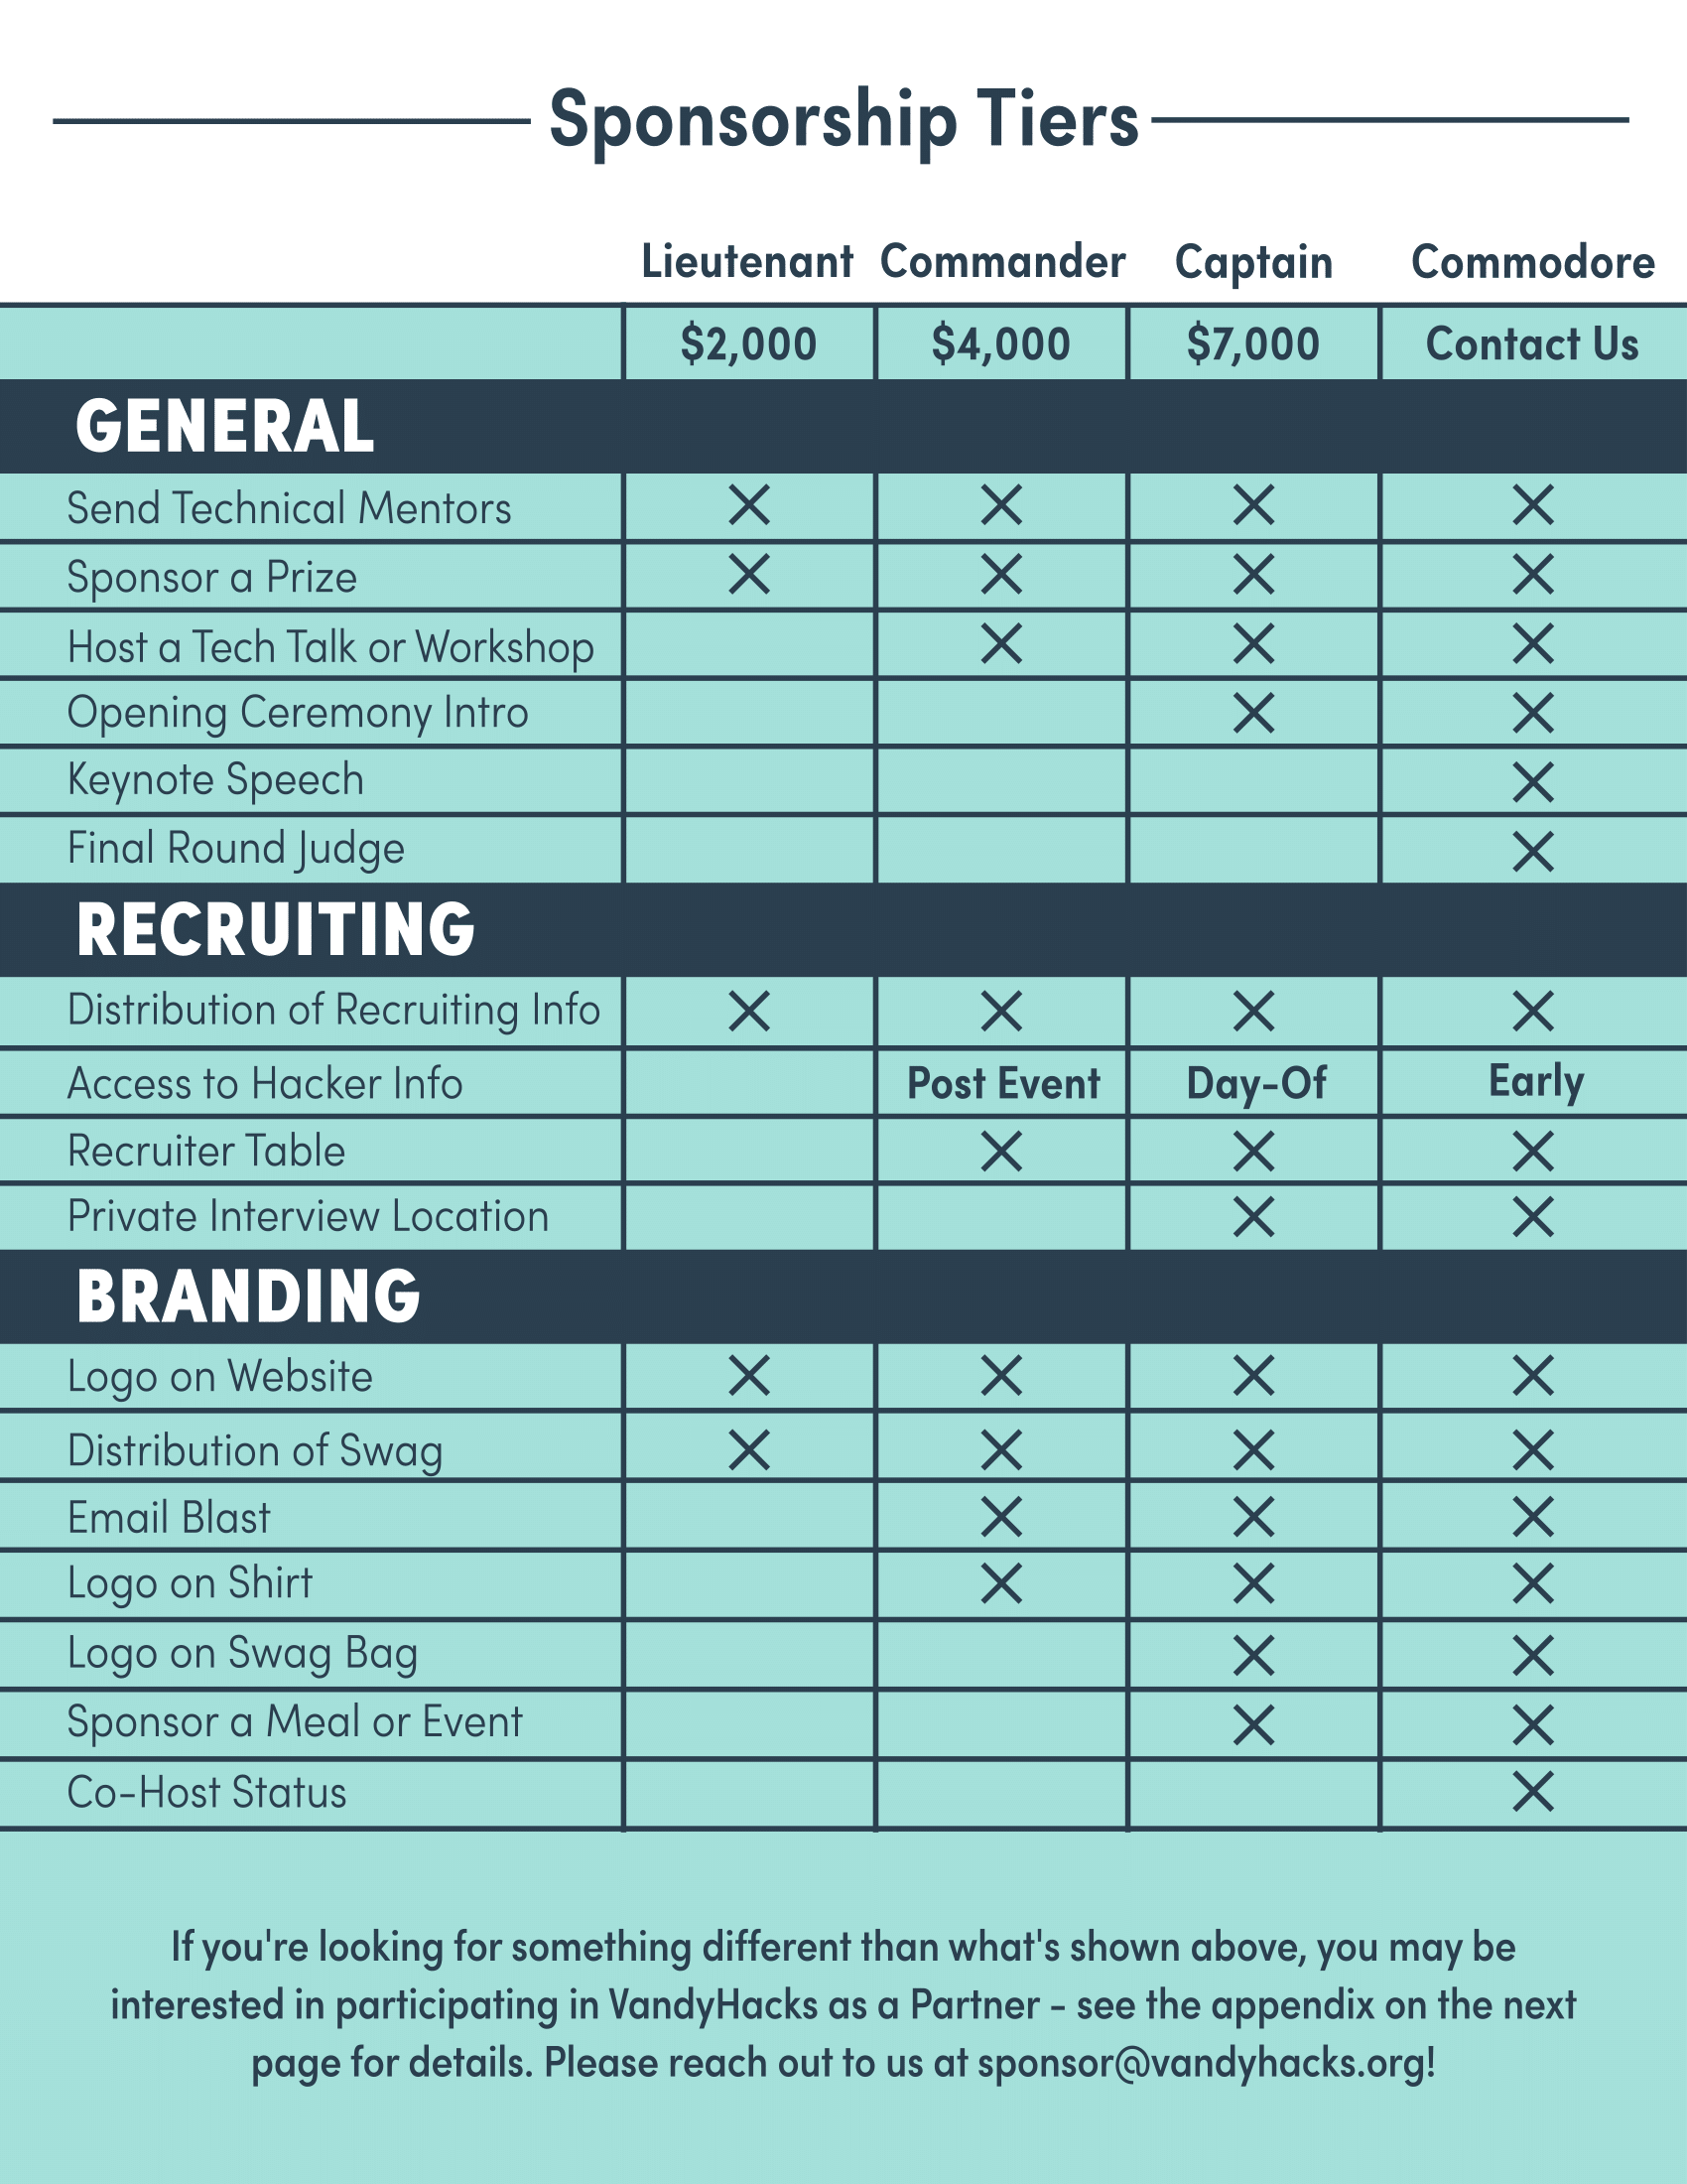
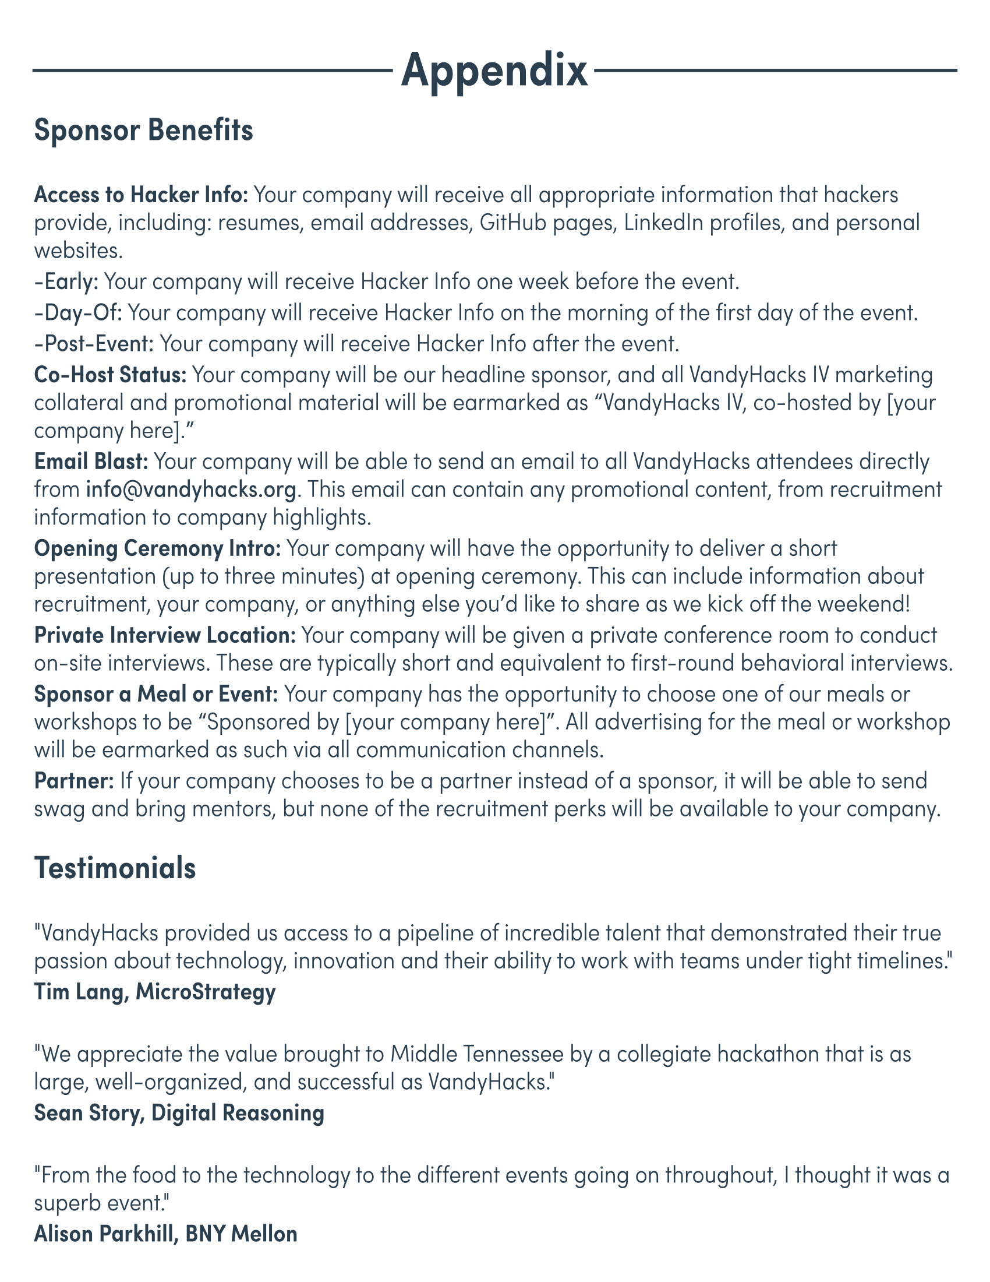
Notes:
0:30 | 18:00
Highlight: Straightforward grid pattern for tiers, clear explanations in appendix where necessary
NOTE
Talk more about how to determine tiers

Slide 26
Utilize tools effectively.
Notes:
0:15 | 18:15

Slide 27
Utilize tools effectively.
Use Google Drive to collaborate
LinkedIn is your friend
Use Hunter.io to find contacts’ email addresses
Have domain-specific email addresses
e.g., irfaan@vandyhacks.org
Notes:
1:15 | 19:30

Slide 28
Use your resources.
Notes:
0:15 | 19:45

Slide 29
Use your resources.
School
Institutional sponsorships
Career center
Career website
Faculty with connections to companies
Community
Companies
Accelerators
Developers
Notes:
1:30 | 21:45

Slide 30
Be a salesman.
Notes:
0:15 | 22:00

Slide 31

Notes:
0:15 | 22:15

Slide 32
Be a salesman.
Know your audience
Cater to the sponsor’s needs
Have a hook
Know what you can offer
Notes:
0:45 | 25:00

Slide 33
Be a salesman.
Initial email
Keep it simple and friendly
Use numbers and stats
End with a question to entice a response
Phone call
Be personable and sell your event
Be prepared to answer questions
Follow up to let the sponsor know you care
Notes:
1:30 | 26:30
NOTE
Show good vs bad email

Slide 34
GROUP DISCUSSION
What are traits of good salespeople that you’ve found useful in hackathon sponsorship?
Notes:
2:00 | 24:15
Talk amongst your groups, and we’ll reconvene in a minute to share some of our thoughts.
NOTE
Not sure about the order here

Slide 35
Be flexible.
Notes:
0:15 | 26:45

Slide 36
Be flexible.
Not all companies can sponsor financially
In-kind sponsorships
Food
Swag and stickers
Prizes
Developer tools (e.g., API keys)
Notes:
1:00 | 27:45

Slide 37
Put on a good show!
Notes:
0:15 | 28:00

Slide 38
Put on a good show!
Be diligent and proactive
Prepare travel, lodging, and other logistics information 6-8 weeks in advance
Be friendly and give your sponsors what they need during the event
Ask for feedback at the end of your event
Paper exit surveys
Notes:
1:30 | 29:30

Slide 39
GROUP DISCUSSION
What questions can you ask on sponsor exit surveys to receive valuable feedback?
Notes:
2:00 | 24:15
Talk amongst your groups, and we’ll reconvene in a minute to share some of our thoughts.
NOTE
Not sure about the order here

Slide 40
What’s next?
Notes:
0:15 | 29:45

Slide 41
https://github.com/IrfaanKhalid/hackathon-sponsorship
or
https://goo.gl/aA2CD6
Notes:
0:45 | 30:30

Slide 42
One comprehensive guide.
Copies of this workshop’s slides and notes
Detailed guide with additional topics
Templates and examples
Feel free to use, share, and fork it!
If you have feedback, email me at irfaan@vandyhacks.org.
Notes:
1:30 | 32:00

Slide 43
Questions and Answers
I’m a hackathon organizer, AMA.
Notes:
13:00 | 45:00

Slide 44
Pre-Register for VandyHacks IV at
https://vandyhacks.org/!
Applications open on Monday, August 7!

Slide 45
THANKS!
Questions or feedback?
You can find me at:
http://irfaan.me/
irfaan@vandyhacks.org

